Slide 1

Chosen People Ministries

Slide 2
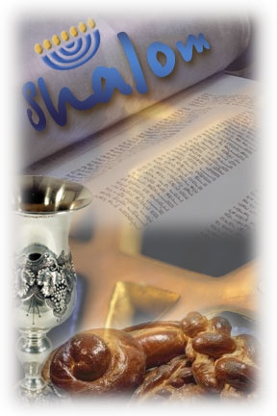
Chosen People Ministries
Exists to glorify God, proclaim the Gospel to the Jew first and also to the Gentile, and develops resources and programs to accomplish this task.

Slide 3
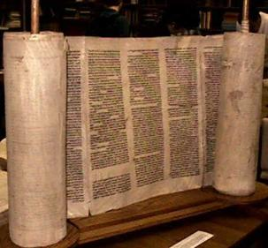
What We Believe
We believe that the Jewish Scriptures predicted the coming of the Messiah through whom one could experience not only the atonement (forgiveness) of sins, but also a personal relationship with God. For example, concerning Messiah, these Scriptures teach us
That…

Slide 4
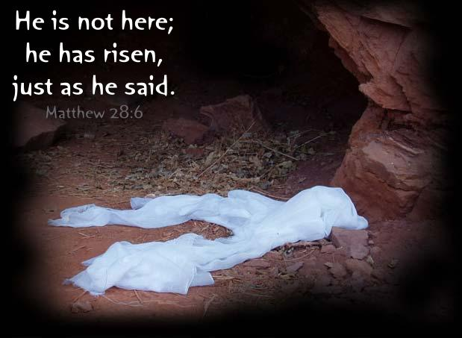
Jesus Messiah would:
be born in Bethlehem (Micah 5:2)
come before the destruction of the Jewish temple in 70 CE (Daniel 9:24-25)
have a miraculous birth (Isaiah 7:14)
be despised and rejected by his people (Isaiah 53:3)
die for us by crucifixion (Psalm 22:16; Isaiah 53:5)
be resurrected from the dead (Psalm 16:10)

Slide 5
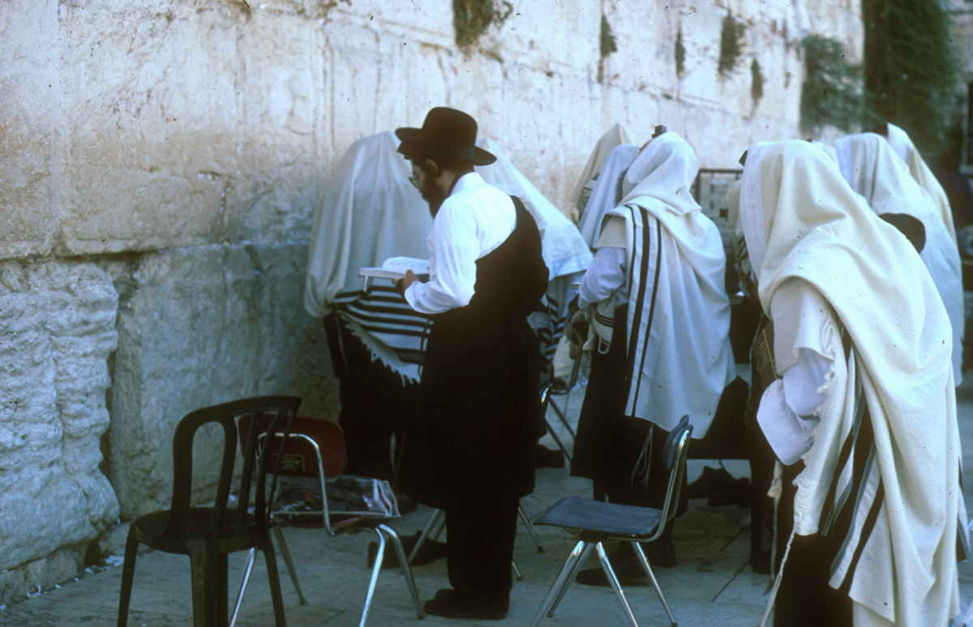
We believe that:
It is God’s Strategy for World Mission that the Gospel should be taken to the Jews. When Jews come to Faith in Christ as Paul anticipated that they will do, in large numbers, mission of the whole humankind will develop and prosper in a new and marvellous way.

Slide 6
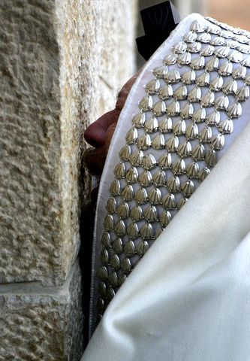
Chosen People Ministries...
Jewish people have been taught that Jewish identity and faith in Jesus are not compatible.
It is part of our mission to show that this is a false concept, and that belief in Jesus the Messiah is the culmination and fulfillment of Jewish identity.

Slide 7
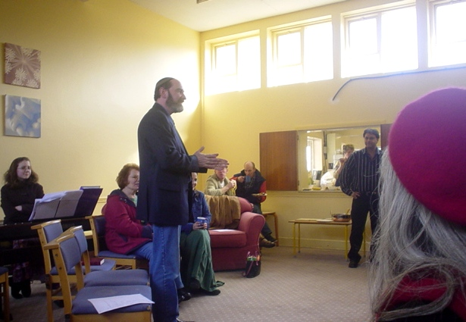
Chosen People Ministries
We have been serving the local churches for over a century by providing presentations that edify, educate and equip believers in their faith...☺

Slide 8
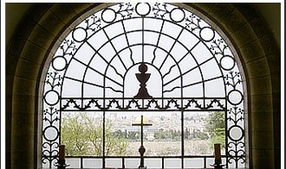
Our Ministry to your Church
Messiah in the Passover Presentation
The Feasts of Israel
Messiah in the Old Testament
The Future of Israel
The Church and the Jewish People
Biblical Feasts of Israel
And many more ...

Slide 9
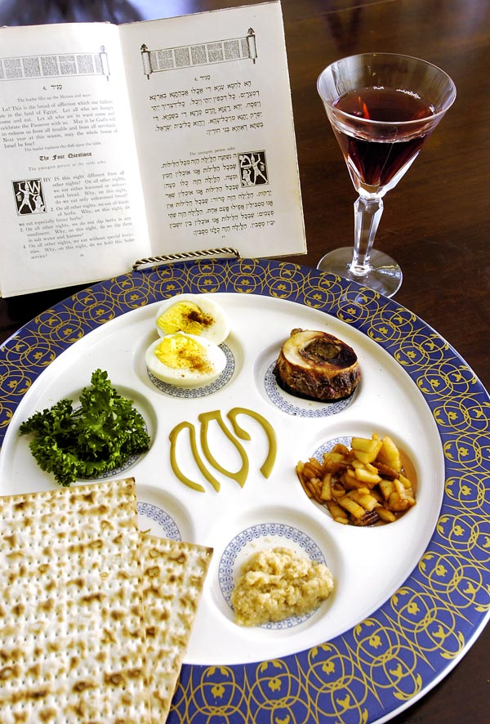
Messiah in the Passover
When God instituted the Passover for the Jewish people, He gave all mankind a picture of what redemption was.
The demonstration illustrates how Jesus Christ the Lamb of God is the fulfillment of the feast- your church members will never forget it!

Slide 10
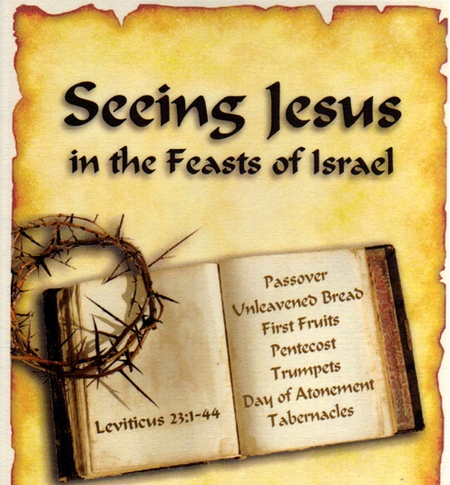
The Feasts of Israel
It is exciting to see how Jesus is portrayed in the Feasts of Israel.
Explore the Jewish roots of your faith through a message on one of these Festivals.
It is good for churches that want to know more about how Jewish customs and traditions illuminate the Gospels.

Slide 11
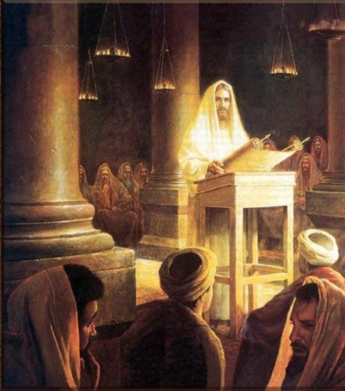
Messiah in the Old Testament
This is a sermon outlining the major prophecies in the OT which predicted the coming of Messiah.
Explores the plan of salvation in the OT and helps Christians to better understand their Jewish neighbours.

Slide 12
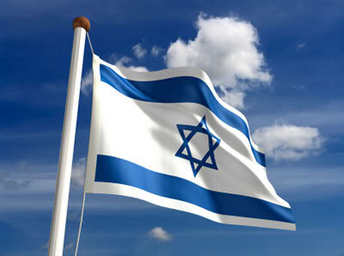
The Future of Israel
God’s plan for the Jewish people and the future of Gentiles and their role in the redemption of Israel
A combination of these messages makes a wonderful series that is well suited for either Sunday morning or evening service

Slide 13
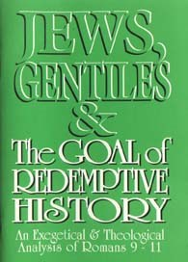
The Church and the Jewish People
Sermon rooted and grounded in Romans 9-11 and examines the relationship that exists between Israel and the Church.
This message will help believers see the need for Jewish evangelism and prayer for them.

Slide 14
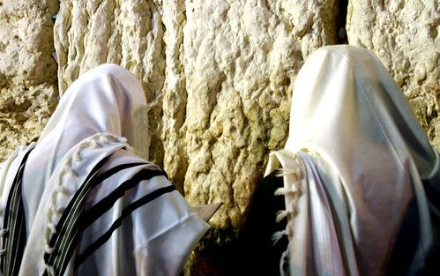
Book a Speaker
Chosen People Ministries is scheduling two of its staff members for meetings this coming year. Fiona Sorbala and Our Executive Director, Daniel Nessin are available throughout the year. Daniel’s personal site is: www.nessim.org.

Slide 15
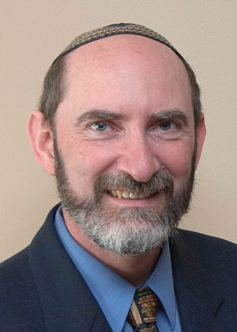
Daniel Nessim, is currently the Executive Director of Chosen People Ministries (UK), leader of Messianic Congregation Beth Sar Shalom, and a trustee of the British Messianic Jewish Alliance.
Daniel is an accomplished speaker who has spoken extensively in Canada, the United Kingdom, the United States, and Israel.
He is available for speaking engagements, television and radio interviews particularly on topics dealing with Biblical Judaism and its relevance to Jewish and non-Jewish believers in Yeshua (Jesus) today. www.nessim.org

Slide 16
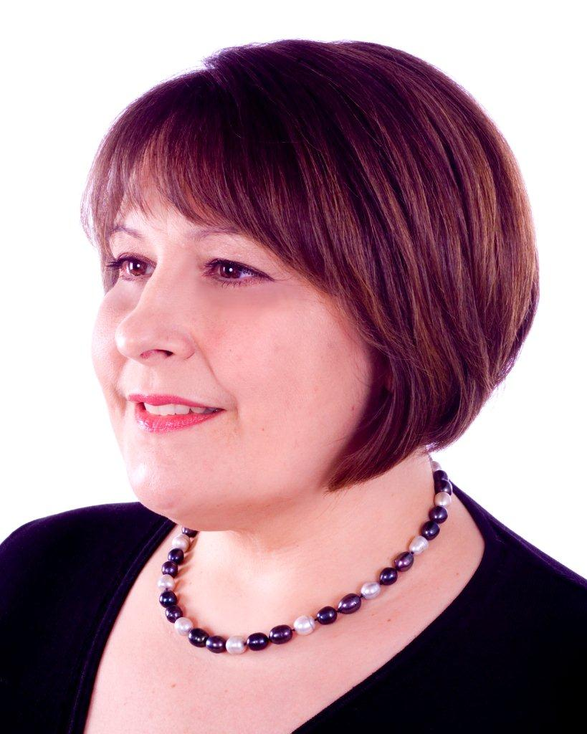
Fiona Sorbala, is currently an evangelist and Bible teacher with Chosen People Ministries (UK), and part of the team at our Messianic Congregation Beth Sar Shalom, and a trustee of the British Messianic Jewish Alliance.
Fiona is an accomplished speaker who has spoken extensively in the Former Soviet Union where she worked in Russia, Ukraine and Moldova, she is now based in London.
She is available for speaking engagements, television and radio interviews particularly on topics dealing with the Jewish Festivals and their relevance to Jewish and non-Jewish believers in Yeshua (Jesus) today, as well as the Jewish roots of the Christian Faith and the lessons of the Tabernacle

Slide 17
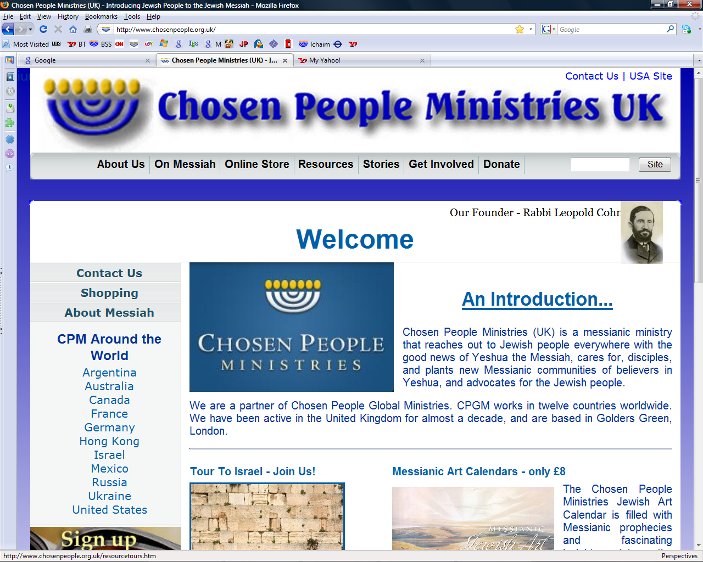
Contact information
To schedule a CPM worker to speak on any of these topics at your church or ministry event contact:
<>< Ramona Muresan
Office Administrator
Chosen People Ministries
PO Box 47871
Golders Green
LONDON NW11 1AL
Phone: 020 8455 7911
ramonam@chosenpeople.org.uk

Slide 18

We have two ministries to churches:
1. help equip the church for Jewish evangelism and
2. demonstrate how a better appreciation of the Jewish roots of the Christian faith can significantly enhance understanding of God's Word.
"How, then, can they call on the one they have not believed in? And how can they believe in the one of whom they have not heard? And how can they hear without someone preaching to them? And how can they preach unless they are sent? As it is written, 'How beautiful are the feet of those who bring good news.'"
Romans 10:14-15

